Slide 1
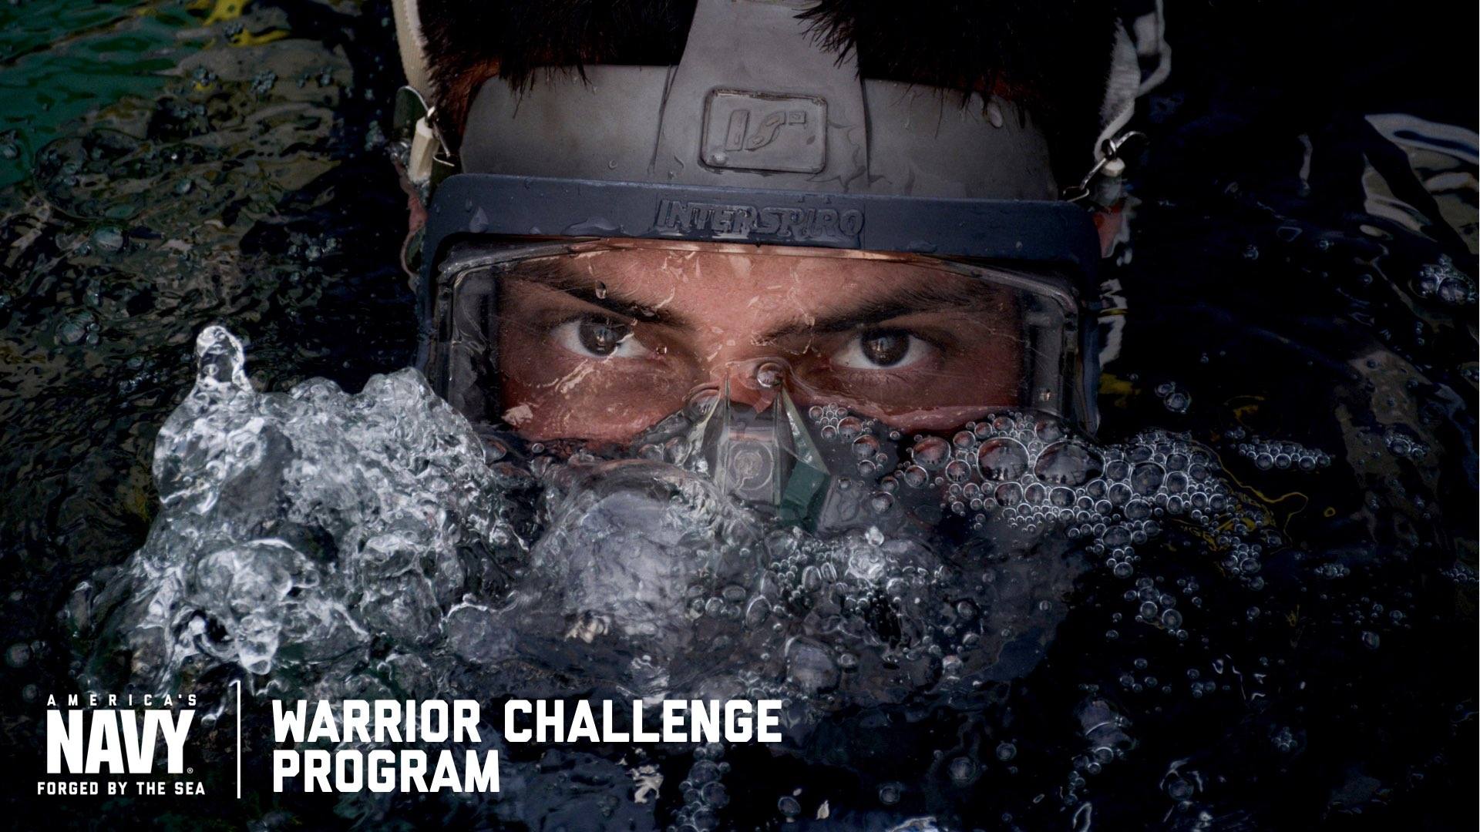
Notes:
PROPOSED TALKING POINTS IN THE NOTES SECTION THROUGHOUT DECK.
Introduce yourself.
Tell your story.
Why did you join the Navy?

Slide 2
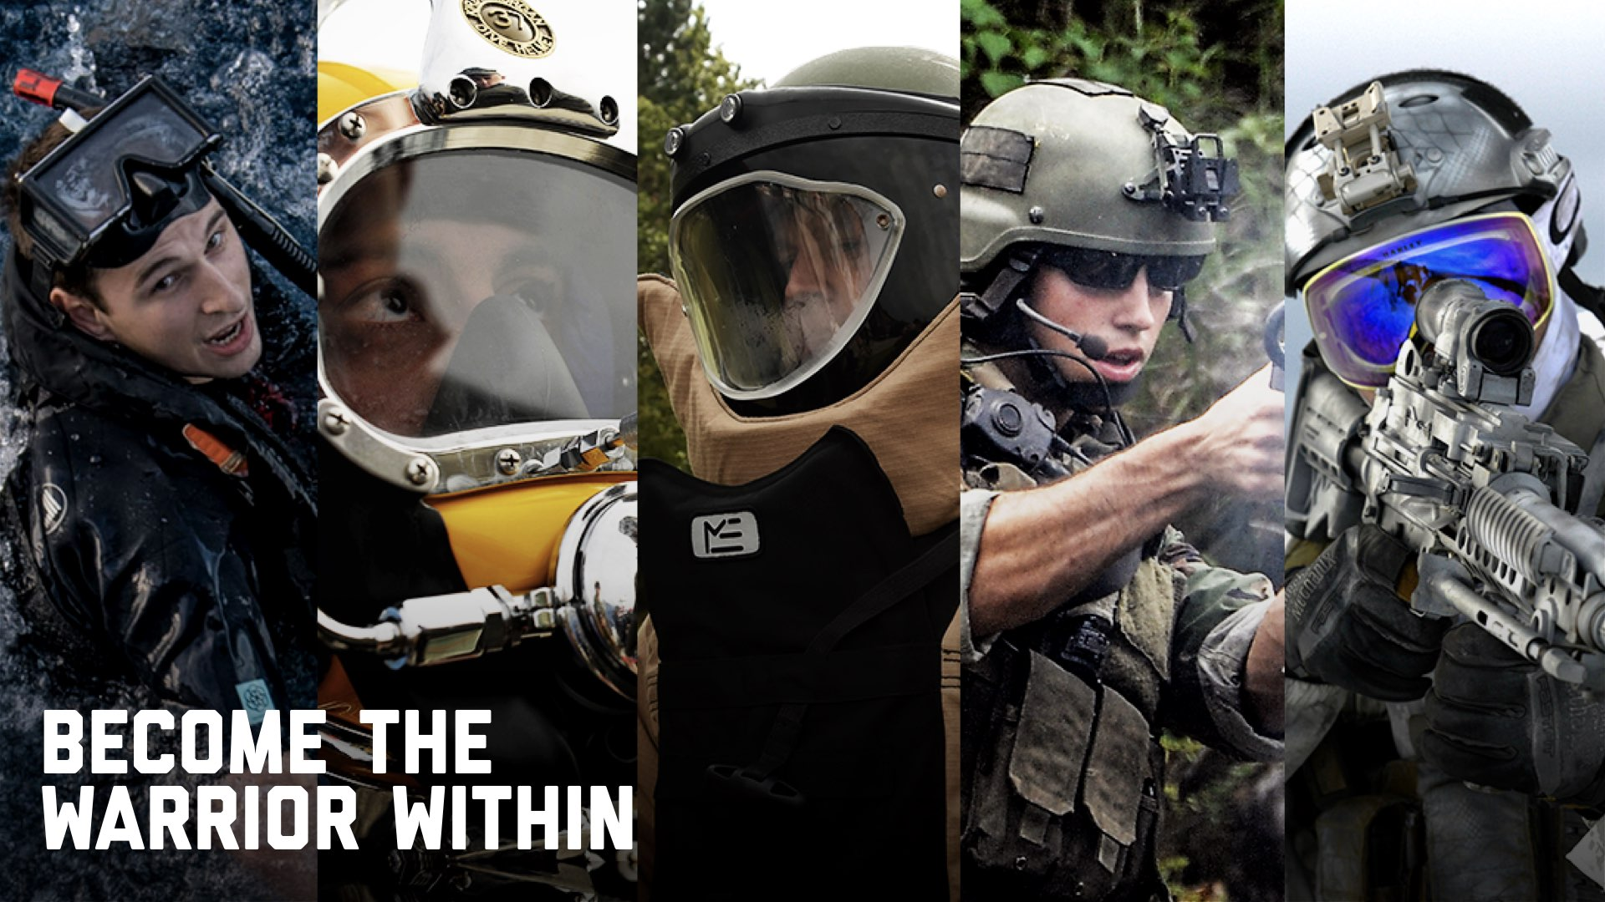
Notes:
The most intense and highly-focused careers we offer are part of the Warrior Challenge Program.
5 careers make up the program:
AIRR
ND
EOD
SWCC
SEAL

Slide 3
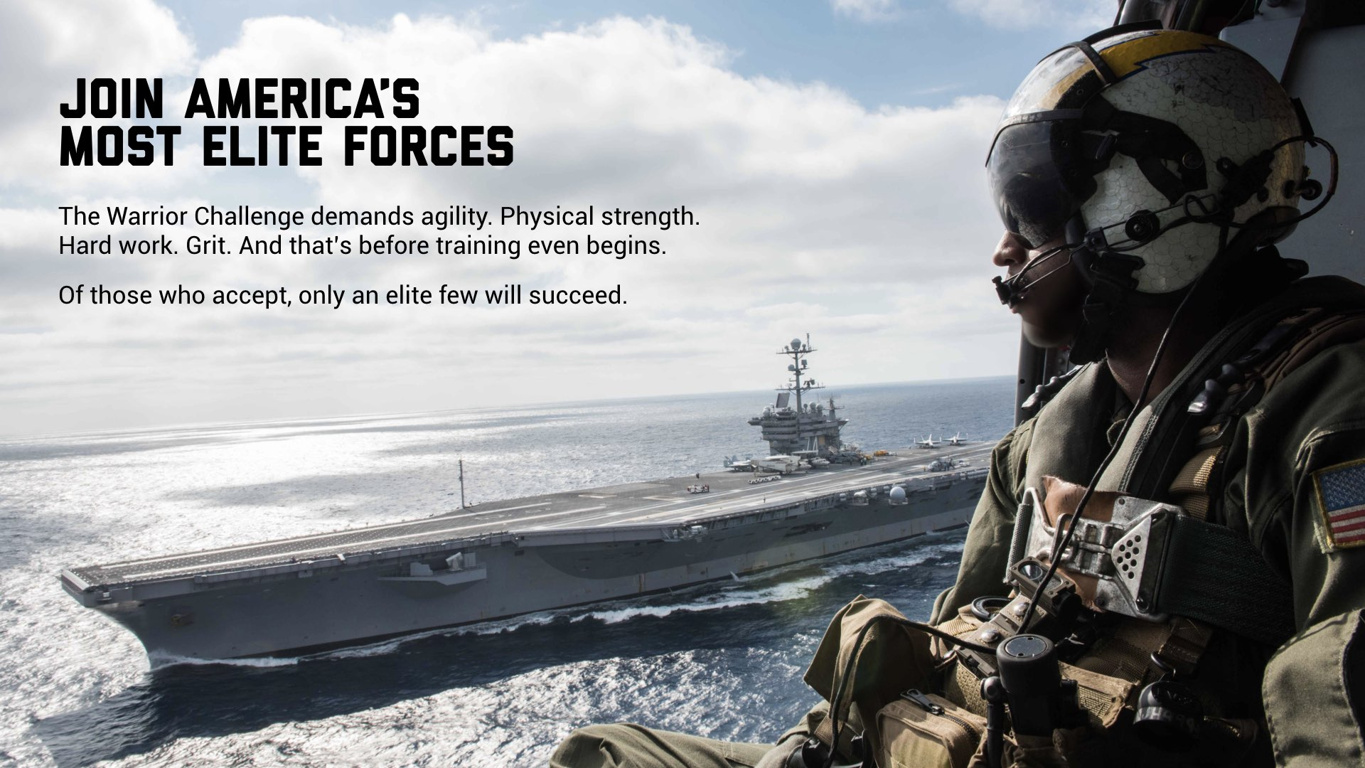
Notes:
You’ll train extensively, push yourself mentally and commit to achieving the impossible.
These jobs require Warrior Toughness; this is not a career path for everyone.

Slide 4
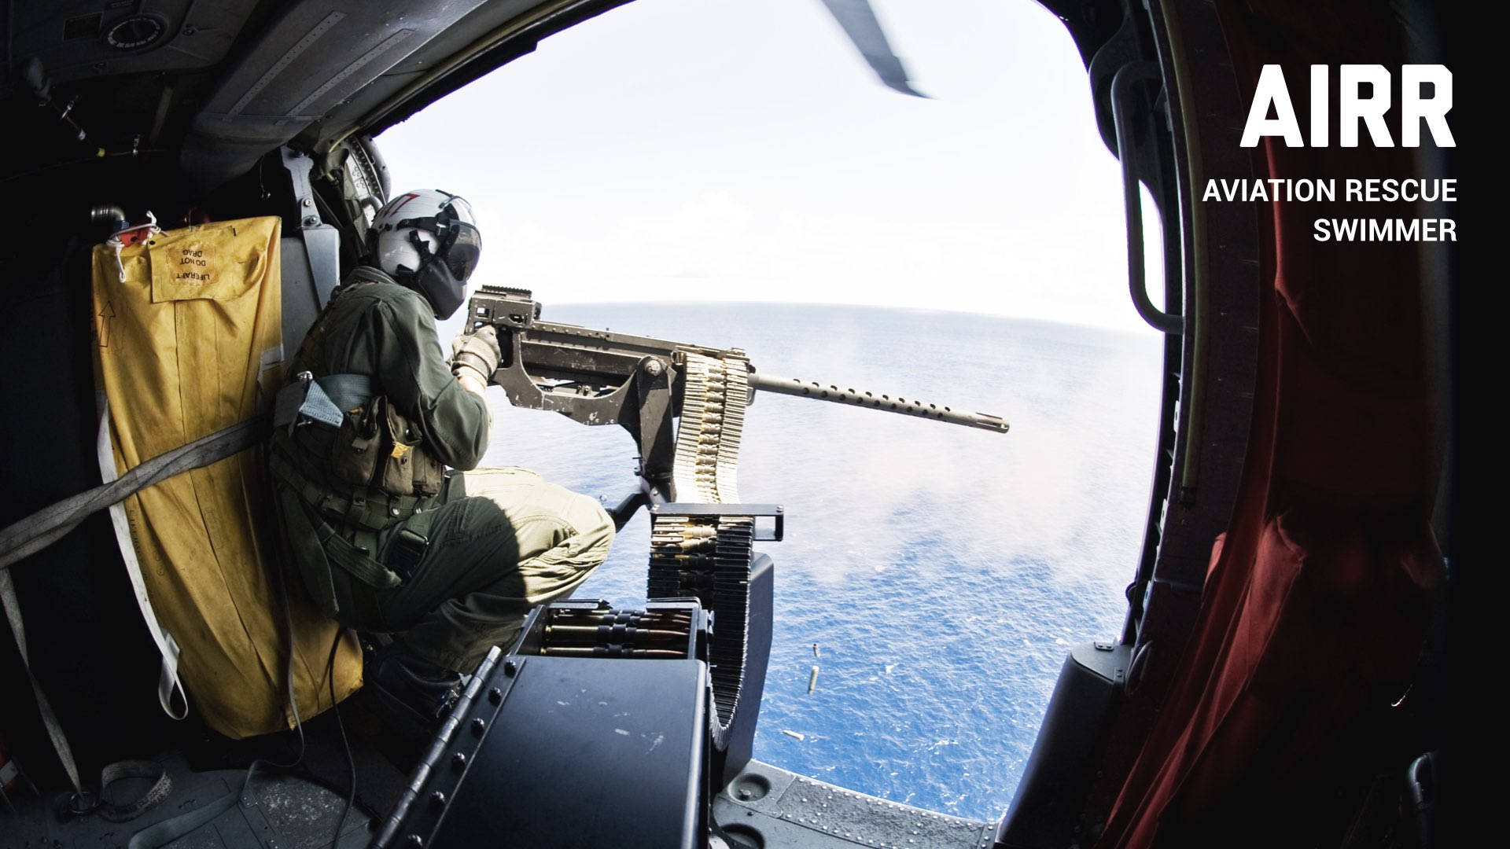

Slide 5
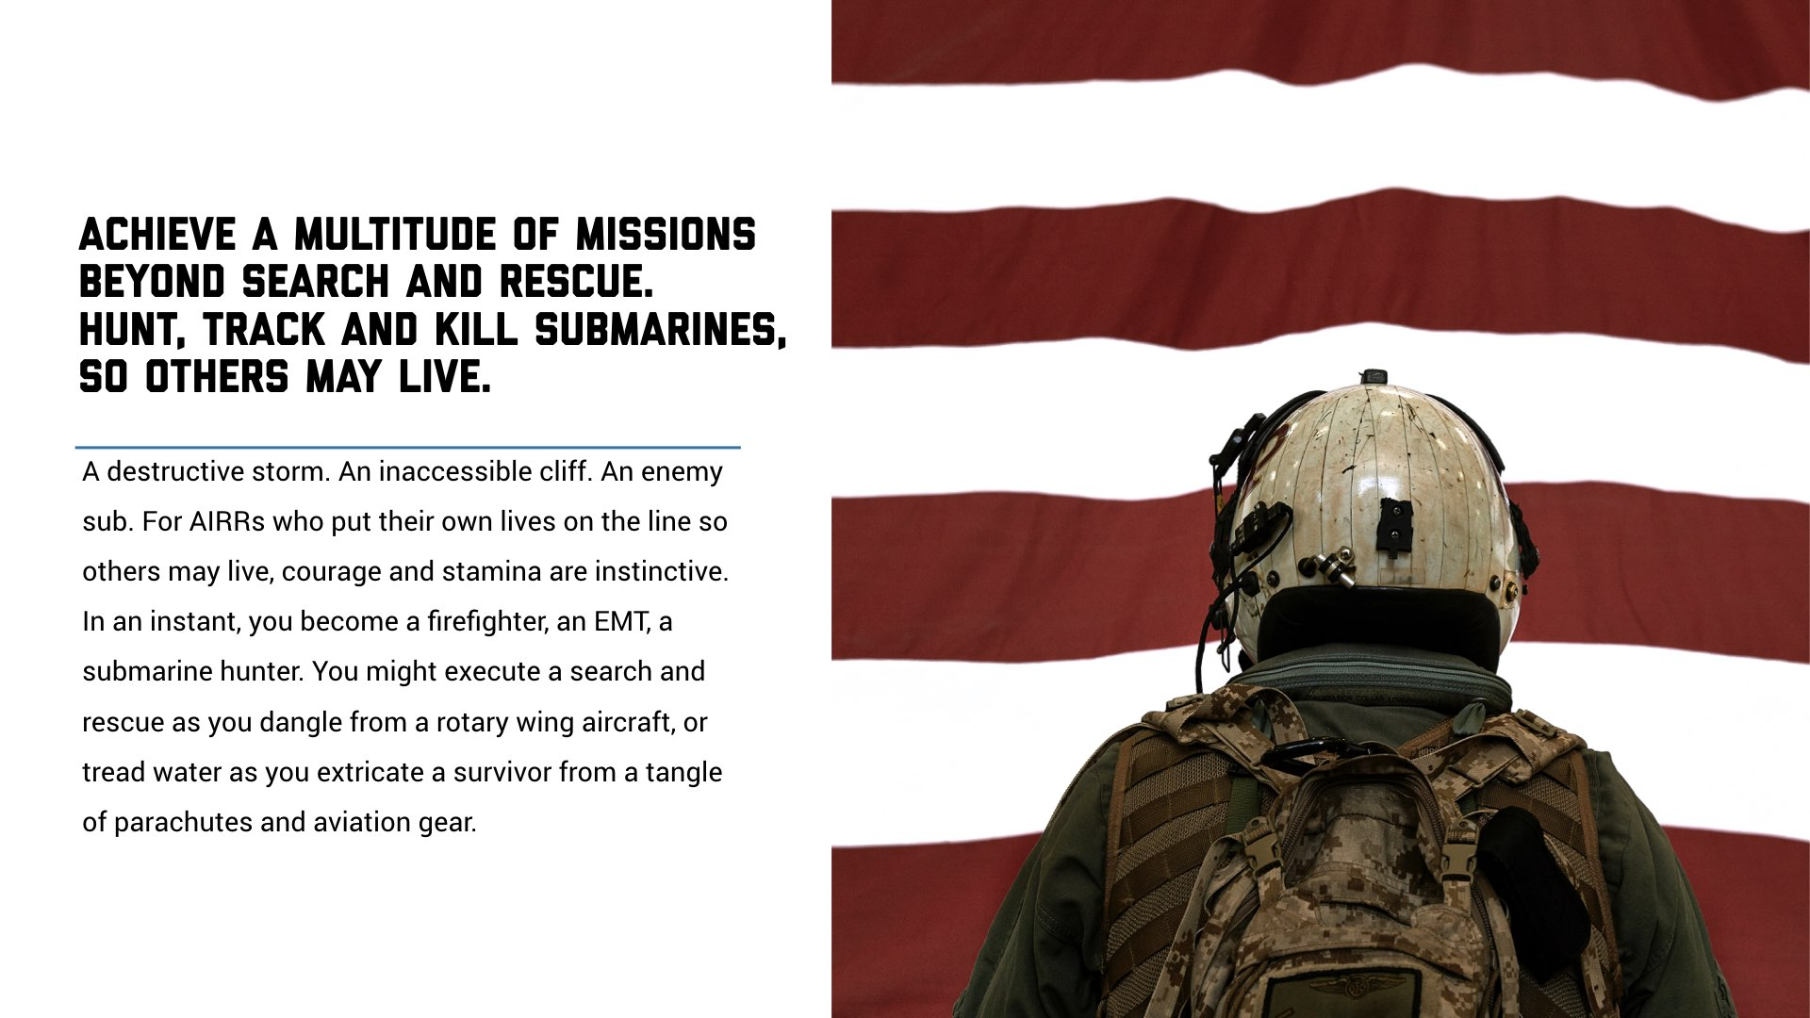
Notes:
As an AIRR, you may help just about anyone, in any environment.
Save pilots of downed aircraft
Track and kill enemy submarines.
Rescue civilians during natural disasters
Operate radar
Conduct surveillance
AIRR motto is “So others may live.”

Slide 6
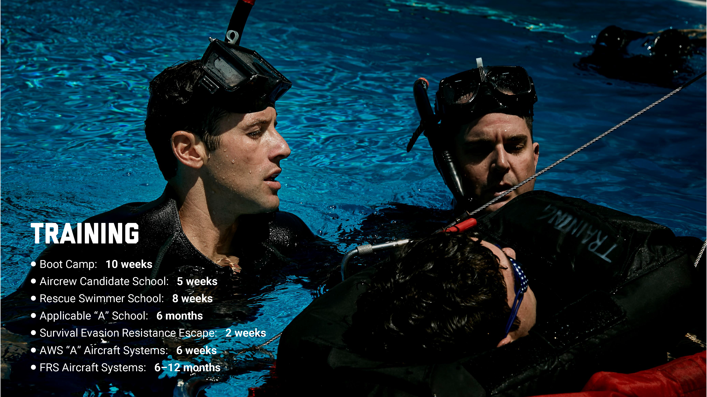
Notes:
63 weeks of training prepare you to operate in any challenging environment.
It’s one of the most demanding, life-altering training programs in the Navy.

Slide 7

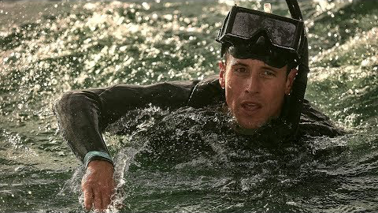

Slide 8
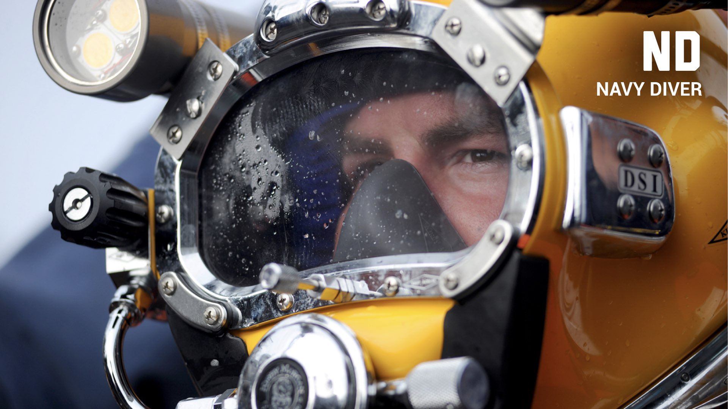

Slide 9
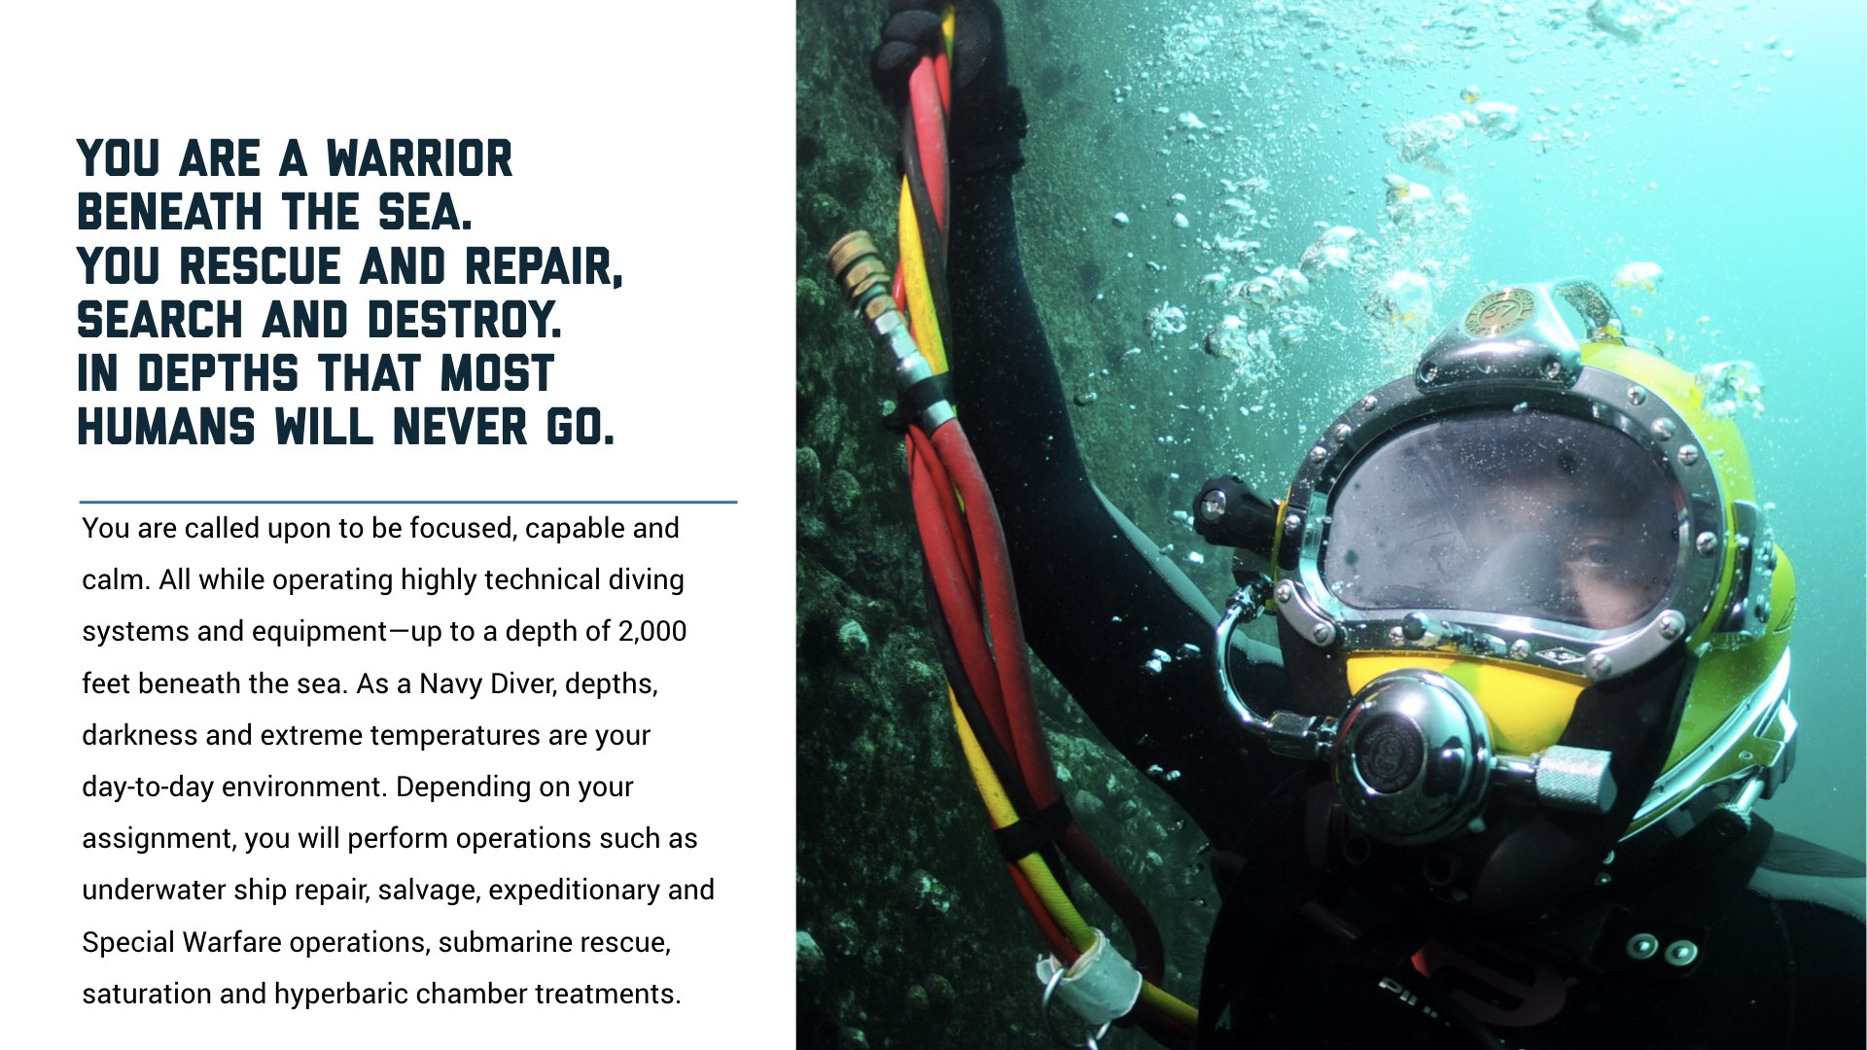
Notes:
Salvage operations
Search and rescue
Construction and demolition projects
Routine ship maintenance, including restoration and repair

Slide 10
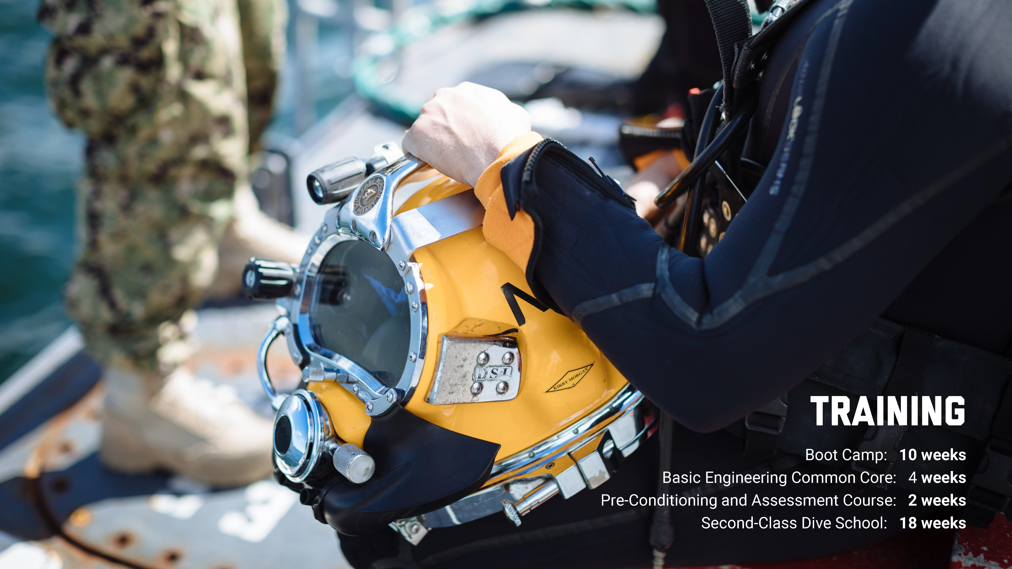
Notes:
32 weeks of training prepare you to join the most elite diving force in the United States military.
Diver prep
Basic electrical and engineering courses
Water adaptability
Physical fitness
Second-class dive school
Underwater cutting and welding
Demolition
Recompression chamber

Slide 11
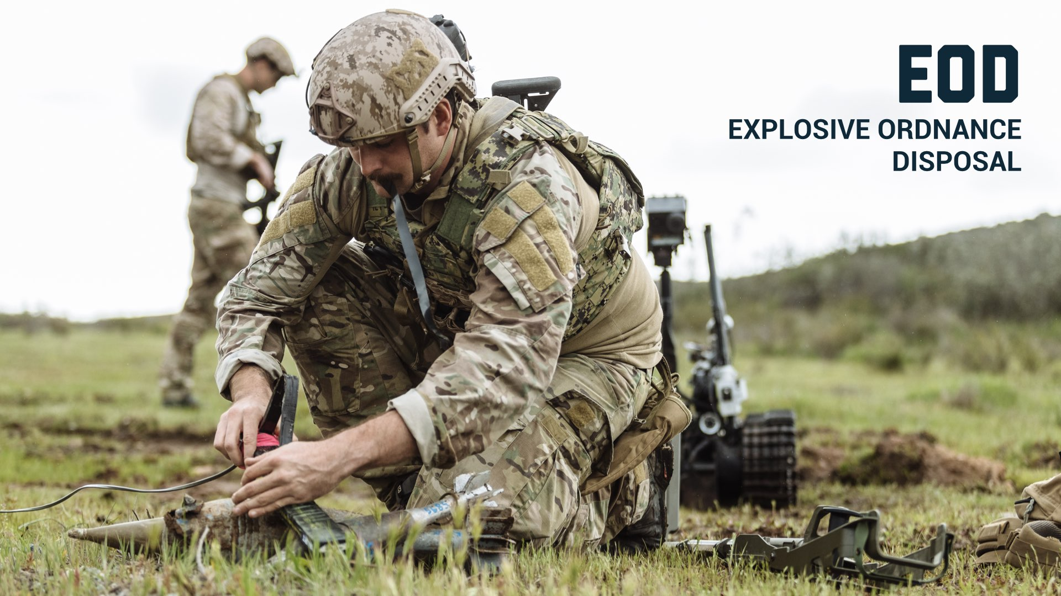

Slide 12
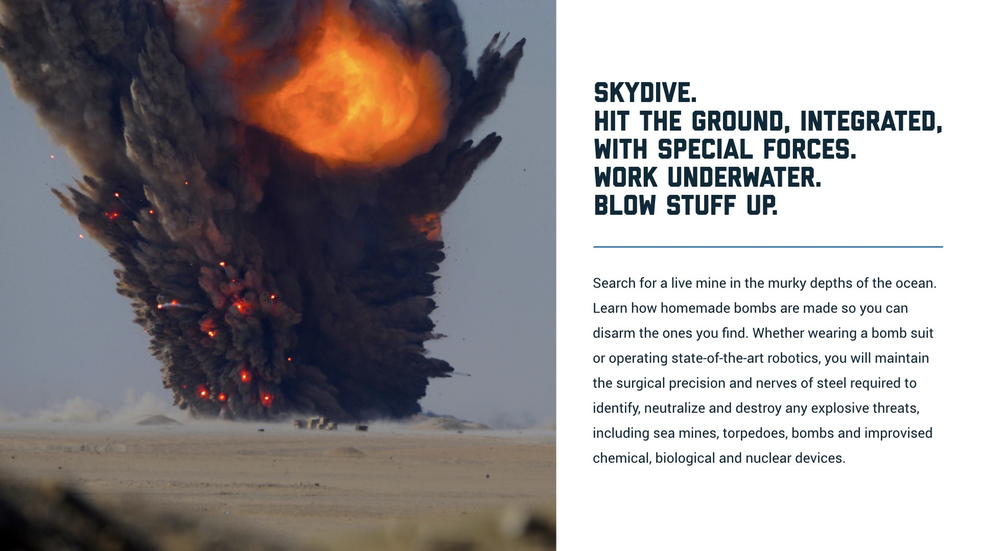
Notes:
You’ll work all over the world to keep the earth a safer place.
Detonate and demolish hazardous munitions, pyrotechnics and outdated explosives
Clear waterways of mines
Protect the President
Assist with security at international events or world summits

Slide 13
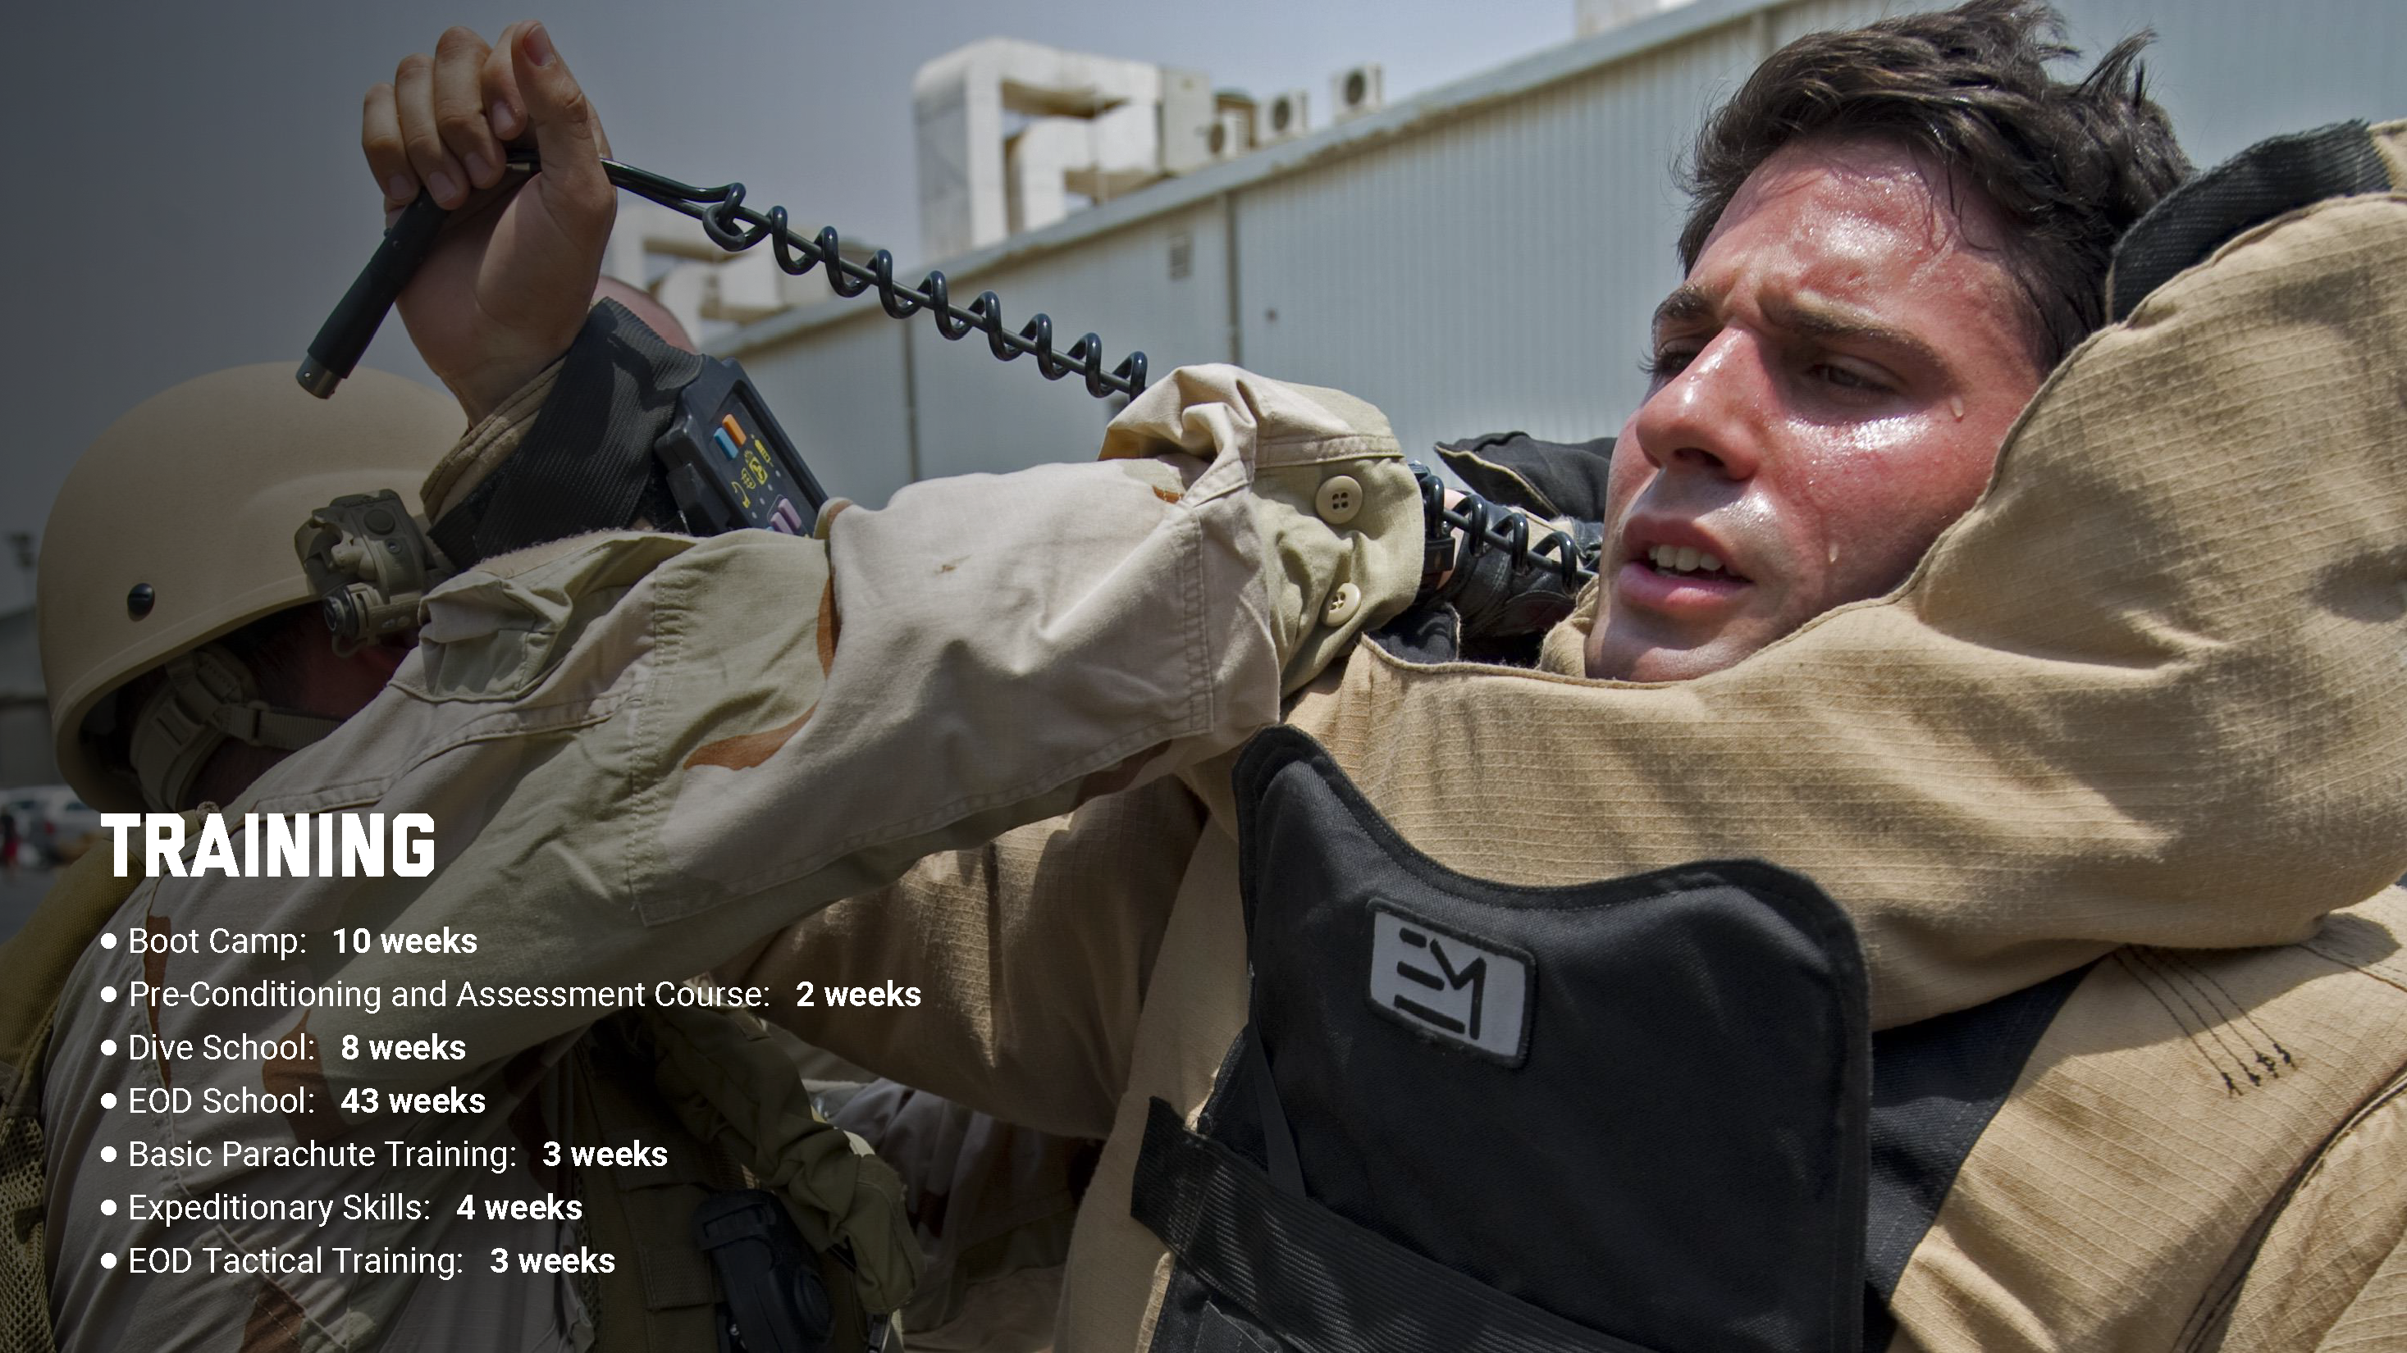
Notes:
Rigorous training lasts over a year (70 weeks) and takes you across the country.
Prep course in Great Lakes, IL
Naval Diving and Salvage Training in Panama City, FL
EOD School in Fort Walton Beach, FL
Parachute training in Fort Benning, GA
Final phase in San Diego, CA

Slide 14
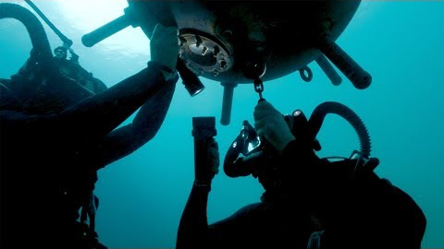


Slide 15
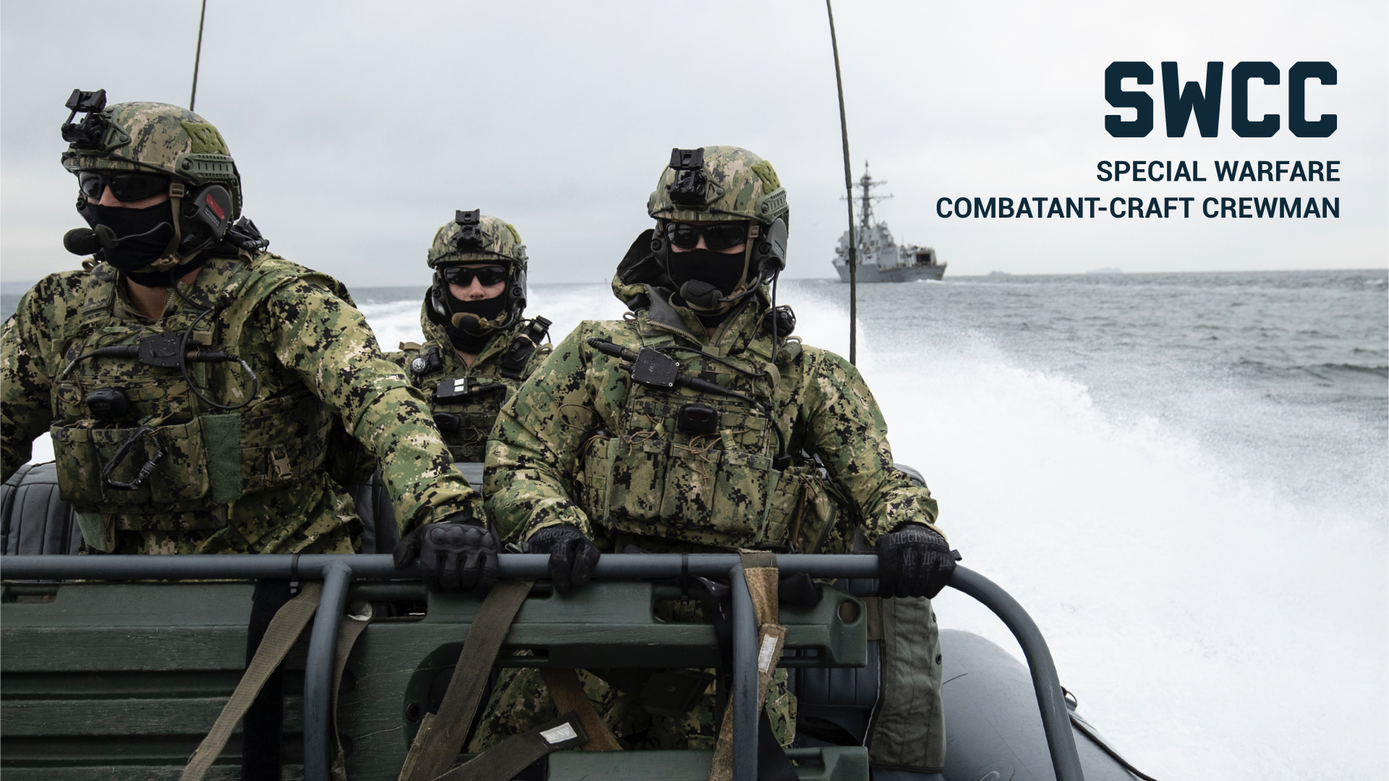

Slide 16
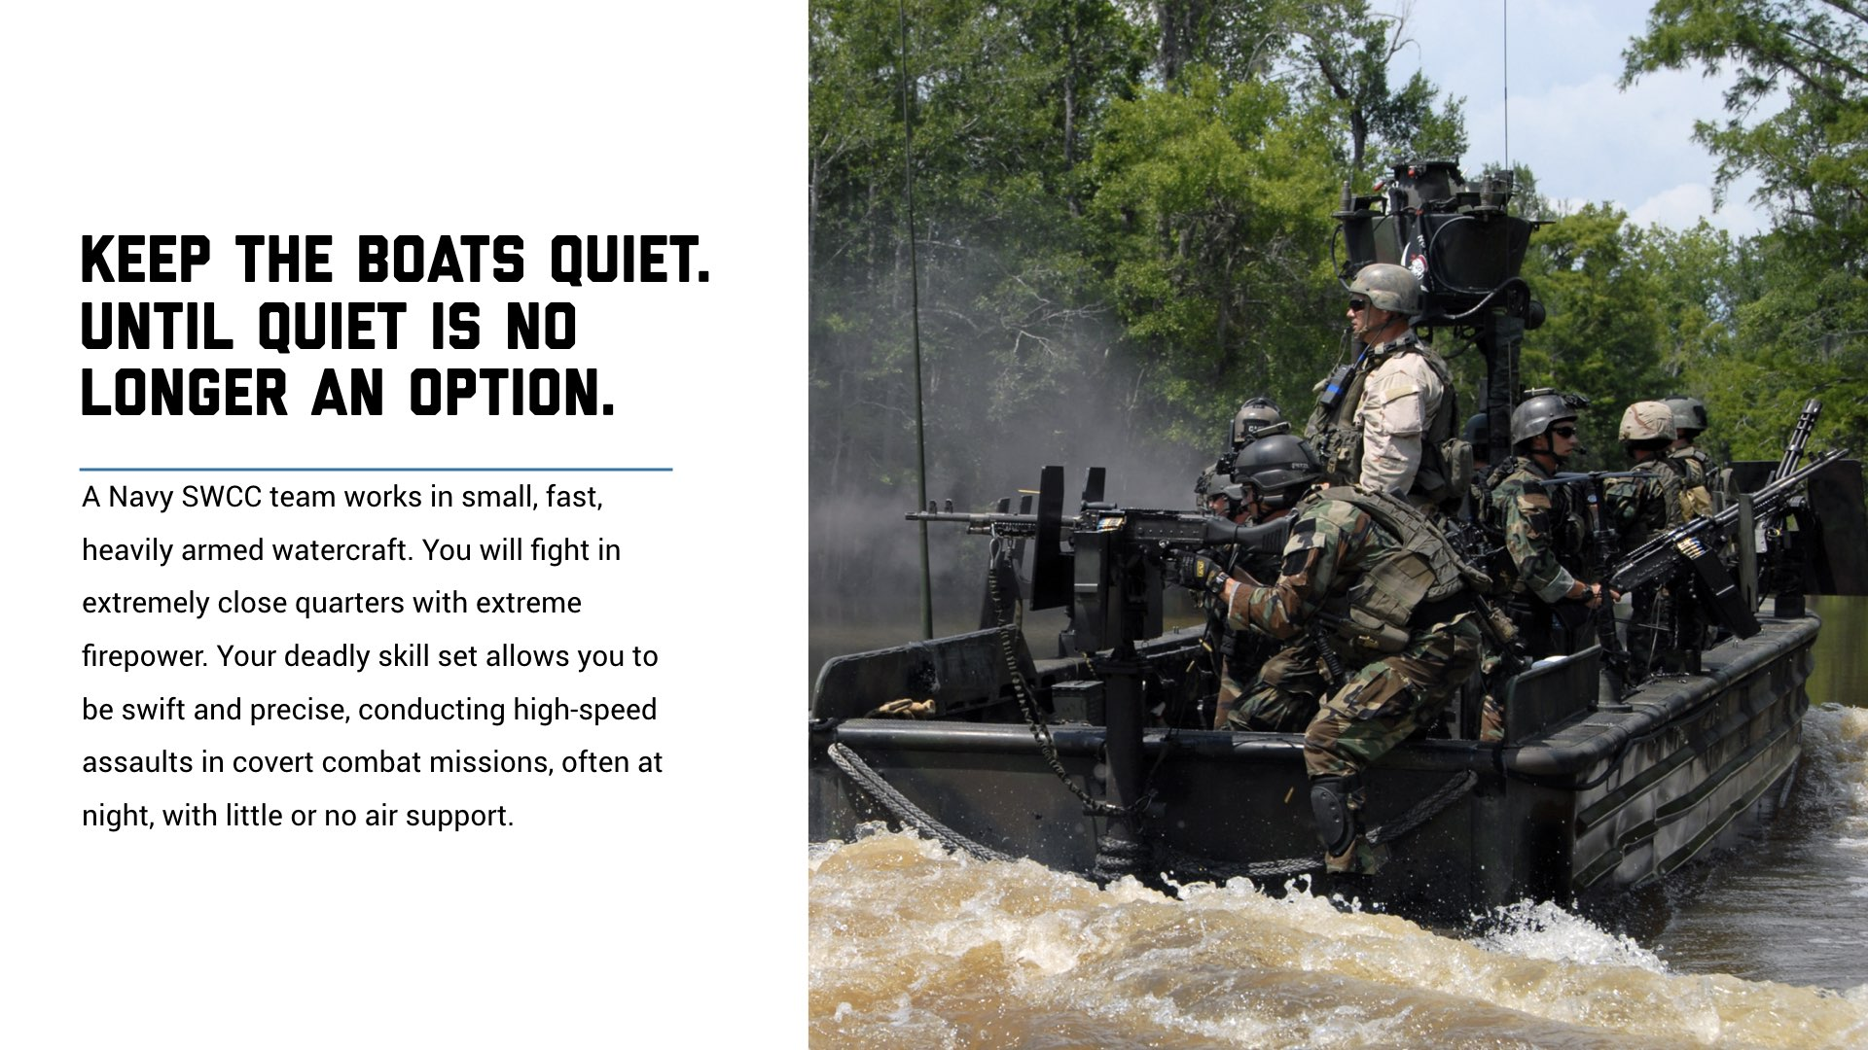
Notes:
Rescue teams from enemy territories
Conduct recon on the enemy
Navigate heavily-armed boats in raids
Work in shallow water where ships can’t operate

Slide 17
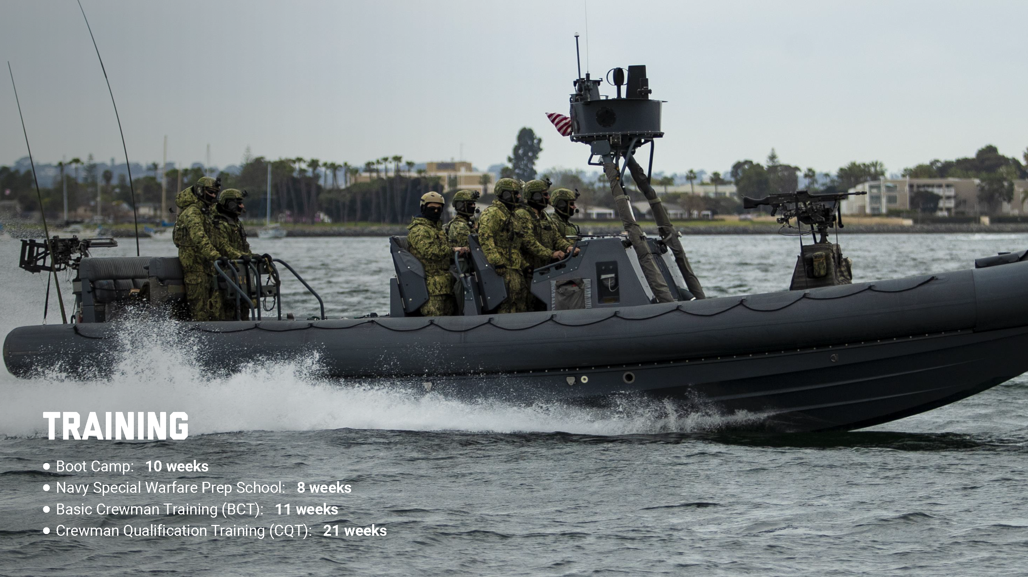
Notes:
SWCC training takes approximately 48 weeks.
A key goal of SWCC training is to make you a stronger person, teammate and leader.

Slide 18
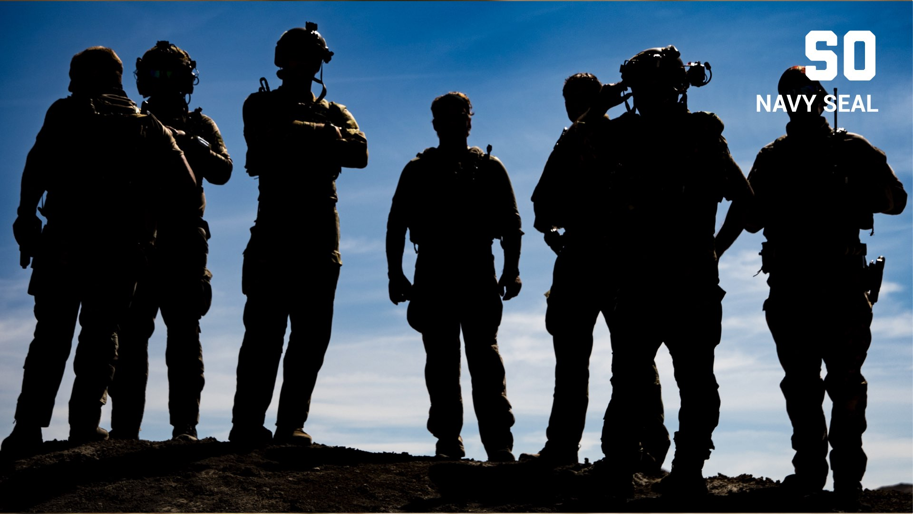

Slide 19
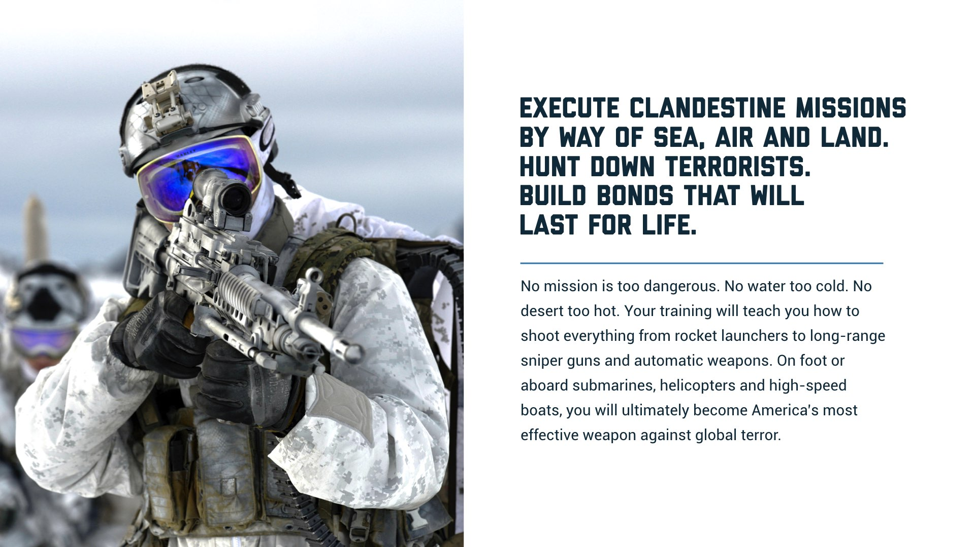
Notes:
SEAL stands for Air, Sea and Land Forces.
The SEALs were established by President John F. Kennedy in 1962.
Covert missions
Direct action warfare
Special recon
Counterterrorism

Slide 20
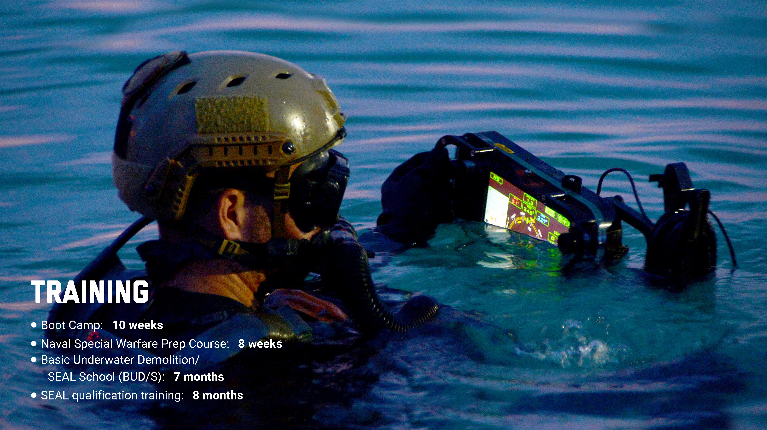
Notes:
Over 1.5 years of training prepares you for the most elite Navy career.
Designed to push you to your physical and mental limits.

Slide 21
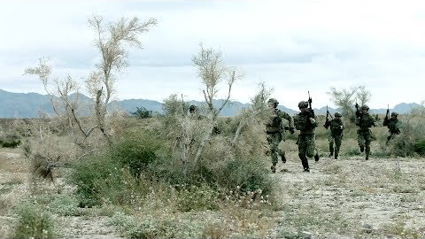

Slide 22
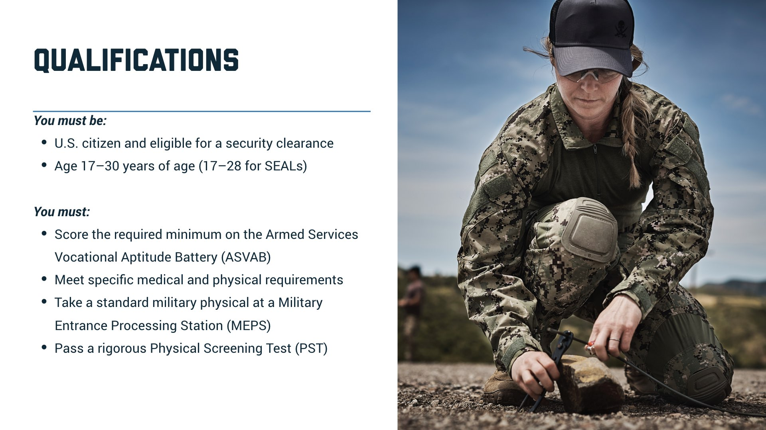

Slide 23
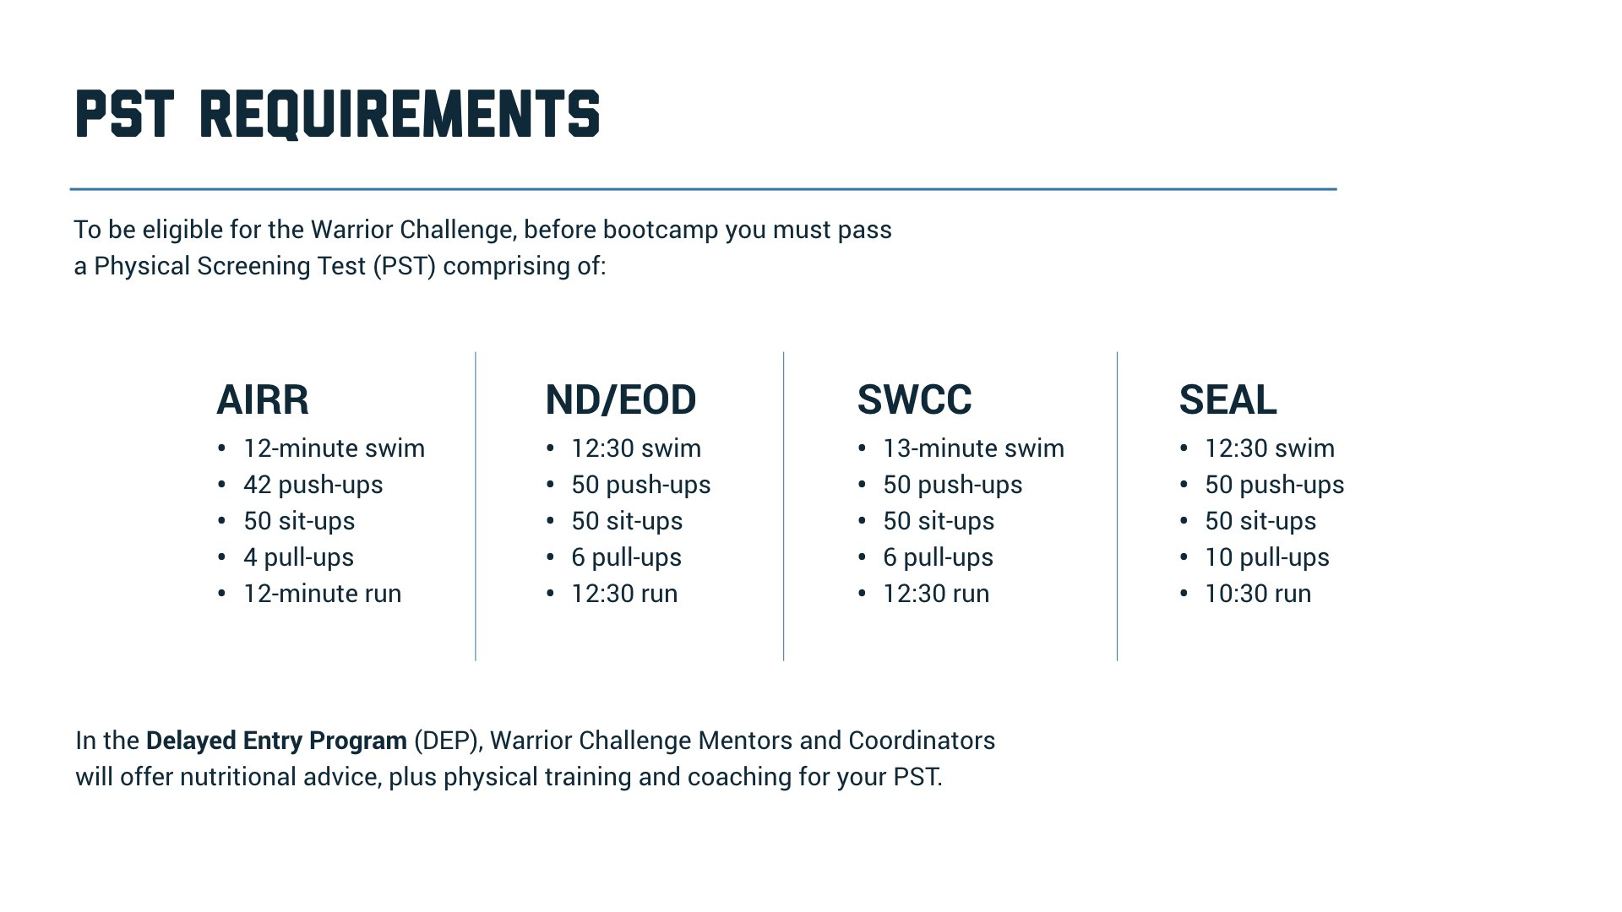
Notes:
Warrior Challenge Program careers have the most physically challenging requirements.
Warrior Challenge Mentors and coordinators are available to help candidates prepare for their PST.

Slide 24

Notes:
A candid conversation with interested participants will help you find those who are great candidates for the Warrior Challenge Program.

Slide 25
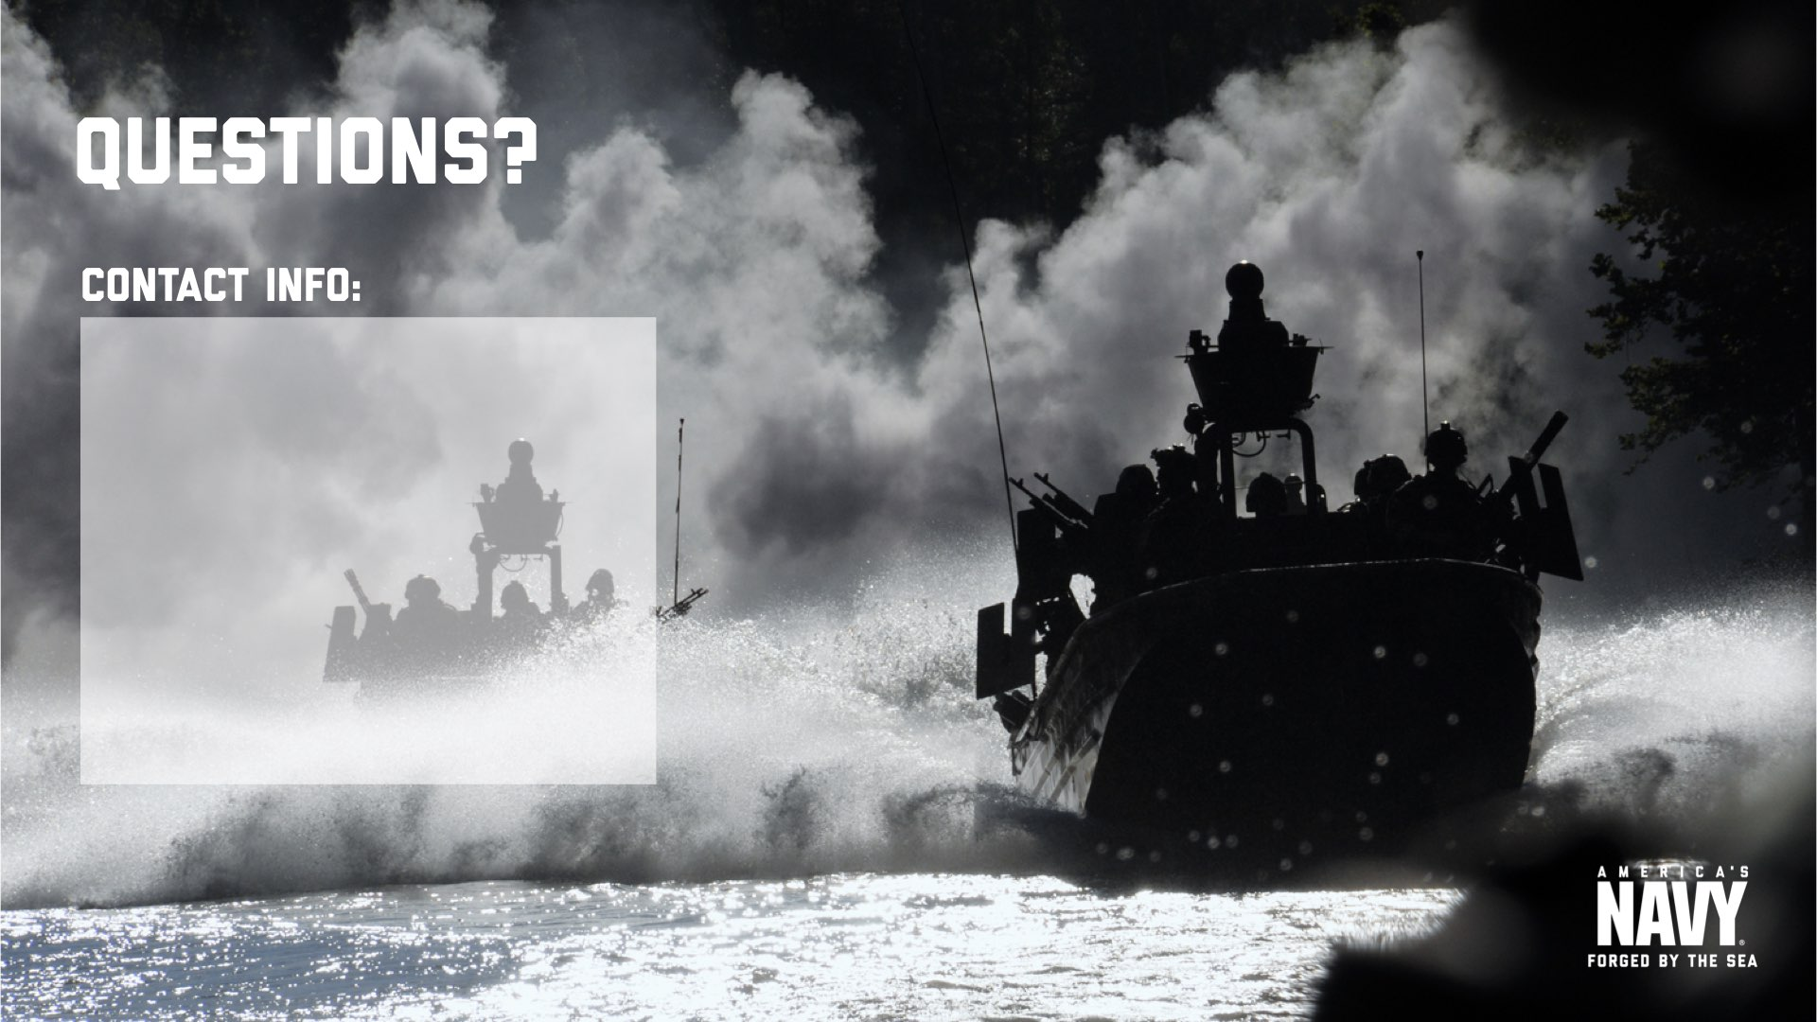
[Recruiter Info Here]
-
-
-
Notes:
[INSERT PERSONAL INFORMATION ABOVE]

